Slide 1
Minimum Spanning Tree
By
Yaseen Ejaz Ahmed

Slide 2
Tree
Non-linear data structure
Collection of nodes that are related with each other

Slide 3
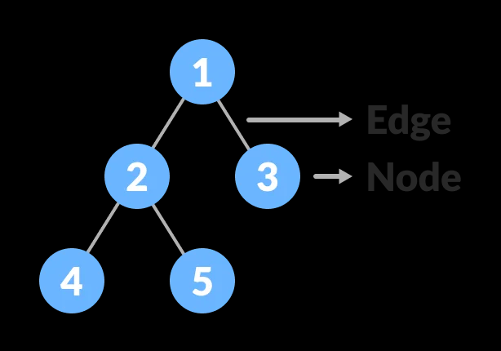
Example of a Tree
Nodes = n
Edges = n-1

Slide 4
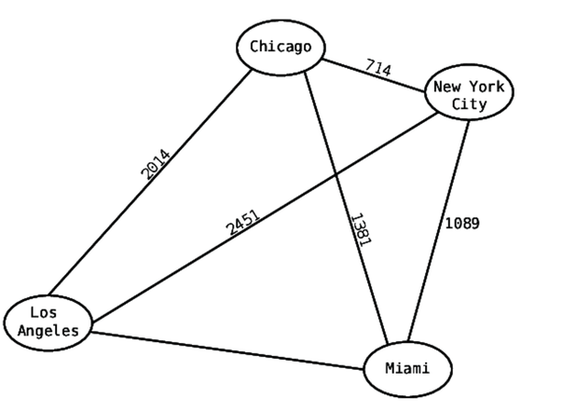
What are Weights?
Weights can be defined as:
Cost of the wire
Distance between two nodes

Slide 5
Weighted Tree
A tree to whose nodes/edges labels are assigned
The labels are usually numbers

Slide 6
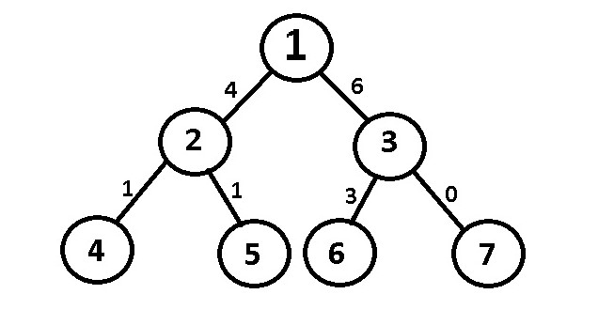
Example of a Weighted Tree

Slide 7
Graph
Non-linear data structure.
The nodes are sometimes also referred to as vertices
The edges are lines or arcs that connect any two nodes in the graph.

Slide 8
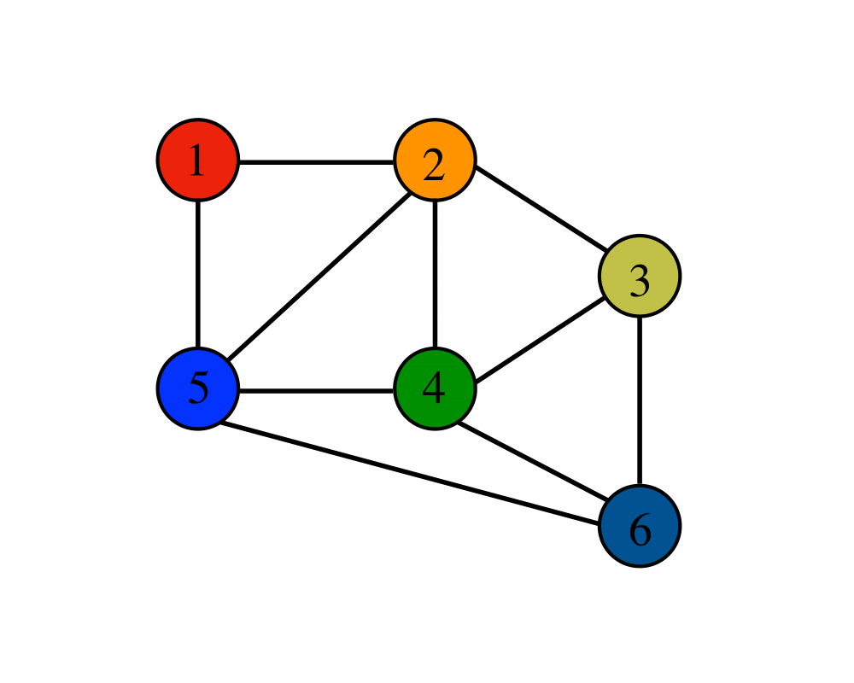
Example of a Graph

Slide 9

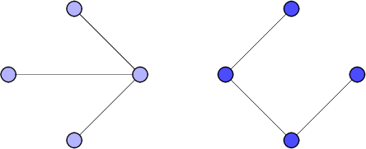
Tree or Graph?

Slide 10
Weighted Graph
Weights are assigned to each edge
These can be directed or undirected

Slide 11
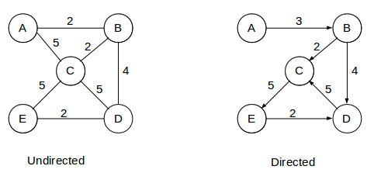
Example of a Weighted Graph

Slide 12
Spanning Tree
Connects all the vertices of a graph with the minimum possible number of edges

Slide 13
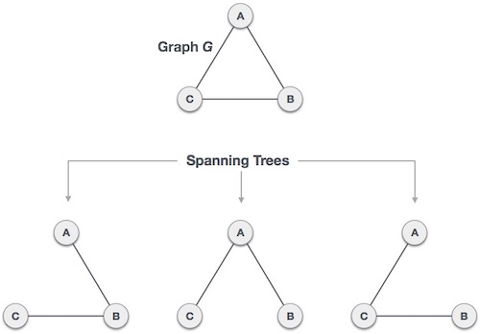
Example of
Spanning Tree

Slide 14
Minimum Spanning Tree
Set of edges in an undirected weighted graph that connects
All the vertices with no cycles
Minimum total edge weight

Slide 15
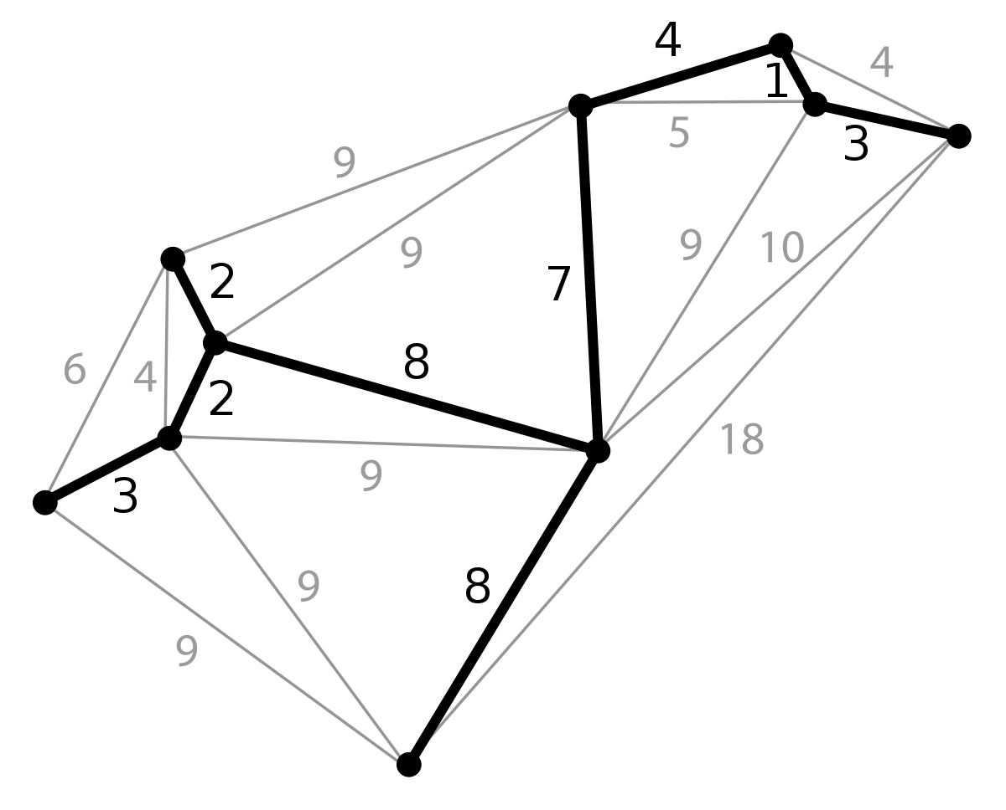
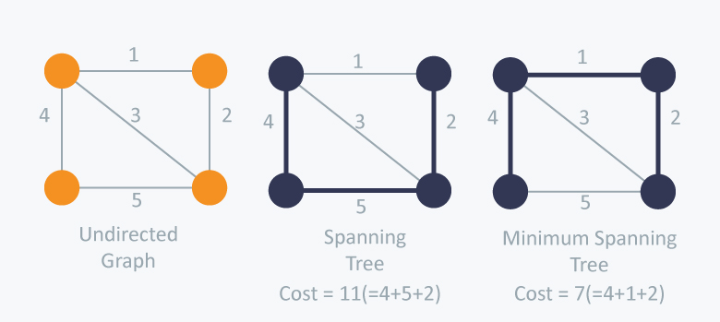
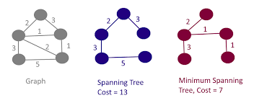

Slide 16
Kruskal's Algorithm

Slide 17
Why do we use this algorithm?
¯\_(ツ)_/¯
Finds a minimum spanning forest of an undirected edge-weighted graph.
If the graph is connected, it finds a minimum spanning tree

Slide 18
Steps of the Algorithm
Step 1: Sort all edges in increasing order of their edge weights.
Step 2: Pick the smallest edge.
Step 3: Check if the new edge creates a cycle or loop in a spanning tree.
Step 4: If it doesn't form the cycle, then include that edge in MST.

Slide 19
Steps of the Algorithm

Slide 20
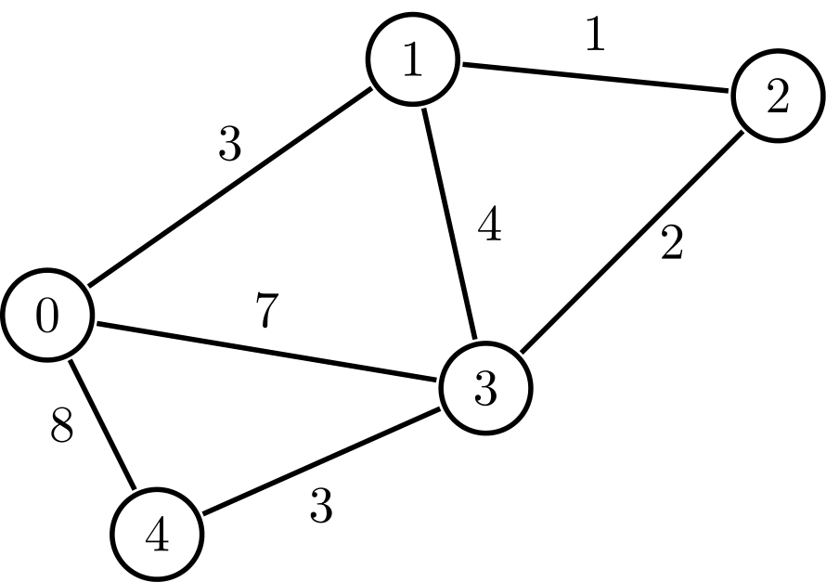

Slide 21
